Slide 1
Auditing Standards Board Activities
Agenda Item 5A
October 2017

Slide 2
Recently Issued Auditing Standards

Slide 3
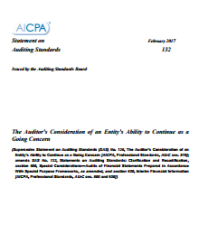
SAS 132, The Auditor’s Consideration of the Entity’s Ability to Continue as a Going Concern
Supersedes SAS 126 of the same title
Issued February 2017
Effective for periods ending on or after December 15, 2017
Notes:
[LAURA]
Revised, using ISA 570 as the base, to reflect ASU 2014-15 and GASB No. 56. This impacted
Definition of reasonable period of time
Definition of substantial doubt
Interim financial statements
Disclosures & management’s plan

Slide 4
SAS 132, Going Concern – Objectives
Going Concern Basis of Accounting
Ability to Continue as a Going Concern
Adequacy of Disclosures
Report Accordingly
Notes:
[LAURA]
To obtain sufficient appropriate audit evidence regarding, and to conclude on, the appropriateness of management’s use of the going concern basis of accounting, when relevant, in the preparation of the financial statements
A2. Management’s use of the going concern basis of accounting is also relevant to financial statements of governmental entities. For example, GASB Statement No. 56, Codification of Accounting and Financial Reporting Guidance Contained in the AICPA Statements on Auditing Standards, addresses the issue of the ability of governmental entities to continue as a going concern for 12 months beyond the financial statement date, and requires consideration of information known to the government that may raise substantial doubt shortly thereafter (for example, within an additional three months).
To conclude, based on the audit evidence obtained, whether substantial doubt about an entity’s ability to continue as a going concern for a reasonable period of time exists
To evaluate the possible financial statement effects, including the adequacy of disclosure regarding the entity’s ability to continue as a going concern for a reasonable period of time
To report in accordance with this SAS

Slide 5
SAS 132, Going Concern - Changes
Required to ask about period beyond management’s assessment
Financial statements prepared in accordance with a special-purpose framework
Going concern basis may not be relevant
Need to consider if substantial doubt exists
Notes:
[ERICA]
GASB does not have going concern basis of accounting
Special purpose framework may not have a going concern

Slide 6
SAS 132 Going Concern - Evaluation
ASB
The period of time required by the applicable financial reporting framework OR
FASB
Within one year after the date that the financial statements are issued
GASB
12 months beyond the date of the financial statements
If no such requirement exists, within one year after the date that the financial statements are issued
Notes:
[ERICA]
ASB : The period of time required by the applicable financial reporting framework OR
If no such requirement exists, within one year after the date that the financial statements are issued (or within one year after the date that the financial statements are available to be issued, when applicable)
FASB Accounting Standards Codification© (ASC) requires management to evaluate whether there are conditions and events, considered in the aggregate, that raise substantial doubt about an entity’s ability to continue as a going concern within one year after the date that the financial statements are issued (or within one year after the date that the financial statements are available to be issued, when applicable).
GASB Statement No. 56, Codification of Accounting and Financial Reporting Guidance Contained in the AICPA Statements on Auditing Standards, requires financial statement preparers to evaluate whether there is substantial doubt about a governmental entity’s ability to continue as a going concern for 12 months beyond the date of the financial statements. GASB Statement No. 56 further requires that, if information is currently known to the governmental entity that may raise substantial doubt shortly thereafter (for example, within an additional three months), such information should also be considered.4 Law or regulation may also set forth requirements regarding management’s responsibility to evaluate the entity’s ability to continue as a going concern for a defined period of time and related financial statement disclosures.

Slide 7
SAS 132 Going Concern – Evaluation: Significant Delay in Issuance
Auditor should inquire about the reasons for the delay.
If the auditor believes that the delay could be related to the evaluation of whether there is substantial doubt about the entity’s ability to continue as a going concern, the auditor should
perform additional audit procedures as necessary
consider the effect on the auditor’s conclusion regarding the existence of substantial doubt about the entity’s ability to continue as a going concern for a reasonable period of time
Notes:
[ERICA]
Significant Delay in the Issuance of Financial Statements 31. If there is significant delay in the expected issuance of the financial statements by management or those charged with governance, the auditor should inquire about the reasons for the delay. If the auditor believes that the delay could be related to the evaluation of whether there is substantial doubt about the entity’s ability to continue as a going concern, the auditor should perform additional audit procedures as necessary, as described in paragraph 16, as well as consider the effect on the auditor’s conclusion regarding the existence of substantial doubt about the entity’s ability to continue as a going concern for a reasonable period of time, as described in paragraph 21.
A25. The inquiry required by paragraph 15 is not intended to require management to extend its evaluation beyond the requirements of the applicable financial reporting framework. Other than inquiry of management, the auditor does not have a responsibility to perform any other audit procedures to identify conditions or events that may raise substantial doubt about the entity’s ability to continue as a going concern for a reasonable period of time beyond the period evaluated by management. A26. The applicable financial reporting framework may provide guidance about whether or how conditions or events that occur after the period required by the applicable financial reporting framework may affect the evaluation of whether substantial doubt about an entity’s ability to continue as a going concern exists. For example, the GASB statements require that, if a governmental entity currently knows of information that may raise substantial doubt shortly after one year beyond the financial statement date, such information should be considered in the evaluation of substantial doubt.27 A27. FASB ASC requires the evaluation to include events and conditions that may raise substantial doubt about the entity’s ability to continue as a going concern within one year after the date that the financial statements are issued (or within one year after the date that the financial statements are available to be issued, when applicable).28 Therefore, the conditions or events known after this time period will not affect the evaluation of whether substantial doubt exists but may affect other disclosure requirements or consideration of whether the financial statements are fairly presented

Slide 8
SAS 132, Going Concern – Reporting
Use of Going Concern Basis of Accounting Is Inappropriate
Adverse Opinion
If the financial statements have been prepared using the going concern basis of accounting but, in the auditor’s judgment, management’s use of the going concern basis of accounting in the preparation of the financial statements is inappropriate
#AICPAgov
Notes:
[ERICA]

Slide 9
SAS 132, Going Concern – Reporting
Use of the Going Concern Basis of Accounting Is Appropriate But Conditions and Events Have Been Identified
Emphasis of Matter Paragraph: If, after considering identified conditions or events and management’s plans, the auditor concludes that substantial doubt about the entity’s ability to continue as a going concern for a reasonable period of time remains
Adverse or Qualified Opinion: If adequate disclosure about an entity’s ability to continue as a going concern for a reasonable period of time is not made in the financial statements
Other Impacts: If management is unwilling to perform or extend its evaluation to meet the period of time required by the applicable financial reporting framework when requested to do so by the auditor, the auditor should consider the implications for the auditor’s report.
Notes:
[ERICA]
25. The emphasis-of-matter paragraph about the entity’s ability to continue as a going concern
for a reasonable period of time should be expressed through the use of terms consistent with
those included in the applicable financial reporting framework. In a going concern emphasis-ofmatter
paragraph, the auditor should not use conditional language concerning the existence of
substantial doubt about the entity’s ability to continue as a going concern for a reasonable period
of time.

Slide 10
SAS 132, Going Concern – Impact on AU-C 930
AU-C 930, Interim Financial Information, amended
Required procedures for when the applicable financial reporting framework does, or does not, require management to evaluate going concern for interim periods
Emphasis-of-matter paragraphs required under specified circumstances
Notes:
[ERICA]
Other financial reporting frameworks may contain other relevant guidance. A14. If management is preparing interim financial statements, FASB ASC requires management to perform a going concern evaluation for the interim periods.24 As a result, the auditor may consider management’s interim evaluation(s) of whether there are conditions and events, considered in the aggregate, that raise substantial doubt about an entity’s ability to continue as a going concern in completing the risk assessment procedures in paragraph 12.

Slide 11
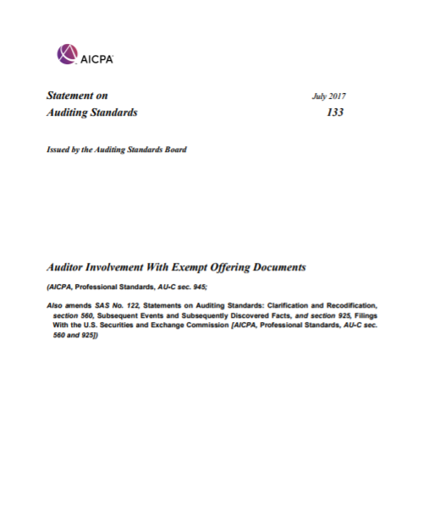
SAS 133, Auditor Involvement with Exempt Offering Documents
Issued July 2017
Effective for exempt offering documents that are initially distributed, circulated, or submitted on or after June 15, 2018
#AICPAgov
Notes:
[LAURA]
Previous guidance included in AICPA guides as best practice regarding municipal securities
Standards-level guidance for when an auditor is considered involved in an offering, as well as the audit responsibilities once involved, is in the public interest and will promote consistency in practice
Historically, the “auditor involvement” guidance in the AICPA guides was considered to be requirements
In updating the guides for the clarity project, several “shoulds” in that guidance could not be linked back to an auditing standard. Existed in the following guides:
State and Local Governments
Health Care Entities
Not-for-Profit Entities
In connection with the Clarity Project, guidance in the AICPA audit guides was scrubbed to determine linkage back to original standards, so they could be appropriately given their new AU-C references.
Anything that did not have a reference to an auditing standard was considered to be nonauthoritative.
Thus, post-clarity its status changed. If you look closely at the guides, the discussion now reads as if these are “best practices.”
The objective of the auditor when involved with an exempt offering document is to perform procedures specified in this SAS to determine whether the information included in the offering document could undermine the credibility of the financial statements and the auditor’s report thereon and respond appropriately.

Slide 12
SAS 133 - Involvement
Auditor’s report (financial statement or review on interim) is included or incorporated by reference in an exempt offering document
-AND-
Auditor performs one or more of the ‘trigger activities’ with respect to the offering document
Notes:
[LAURA]
References in this SAS to an auditor’s report are to be read to encompass an auditor’s report on financial statements or an auditor’s review report on interim financial information in accordance with AU-C section 930, Interim Financial Information.
An auditor’s report in accordance with AU-C section 700, Forming an Opinion and Reporting on Financial Statements, AU-C section 800, Special Considerations—Audits of Financial Statements Prepared in Accordance With Special Purpose Frameworks, or AU-C section 805, Special Considerations—Audits of Single Financial Statements and Specific Elements, Accounts, or Items of a Financial Statement.
If any such report is included in the offering – you have met #1
Will address each of the trigger activities in more depth

Slide 13
SAS 133: Triggering Activities
Trigger activities are
Assisting the entity in preparing information included in the offering document
Reading a draft of the offering document at the entity’s request
Issuing a comfort letter
Participating in due diligence discussions
Issuing an attestation report on information relating to the exempt offering
Providing written agreement for the use of the auditor’s report in the offering document
Updating the auditor’s report for inclusion in the offering document
Notes:
[LAURA]
Assisting the entity in preparing information included in the exempt offering document (Ref: par. A9—A11)
Reading a draft of the exempt offering document at the entity’s request (Ref: par. A12)
Issuing a comfort or similar letter in accordance with AU-C section 920, Letters for Underwriters and Certain Other Requesting Parties, or a practitioner’s report on an attestation engagement in lieu of a comfort or similar letter on information included in the exempt offering document (Ref: par. A13—A15)
Participating in due diligence discussions with underwriters, placement agents, broker-dealers, or other financial intermediaries in connection with an exempt offering document (Ref: par. A16)
Issuing a practitioner’s report on an attestation engagement on information relating to the exempt offering (Ref: par. A17—A18)
Providing written agreement (for example, an inclusion letter) for the use of the auditor’s report in the exempt offering document (Ref: par. A19—A21)
Signing a copy of the auditor’s report for inclusion in the exempt offering document (Ref: par. A22)

Slide 14
SAS 133 - Requirements When Involved
Other Information:
Perform the procedures described in paragraphs .06–.18 of AU-C section 720, Other Information in Documents Containing Audited Financial Statements, on the exempt offering document
Subsequent Events/Subsequently Discovered Facts:
Perform procedures designed to identify events occurring between the date of the auditor’s report and the date of the distribution, circulation, or submission of the exempt offering document that, had they been known to the auditor as of the date of the auditor’s report, may have caused the auditor to revise the auditor’s report (subsequent events).
Notes:
[LAURA]
OTHER INFORMATION:
Mention that the best practice guidance referred to AUC 720 broadly and that SAS limits to just these paragraphs.
However, this responsibility is in line with what the best practice guidance had the auditor doing.
Identify material inconsistencies, if any, with the audited financial statements
Communicate with those charged with governance the auditor’s responsibility with respect to the other information
Follow guidance in AU-C 720 if material inconsistencies or material misstatements of fact are identified
A27. When revision of the other information in the exempt offering document is necessary due to a material inconsistency or a material misstatement of fact that management refuses to correct, AU-C section 720 requires the auditor to notify those charged with governance of the auditor’s concerns regarding the other information and take any further appropriate action. With regard to exempt offerings, actions may also include determining whether to withhold the auditor’s agreement to include the auditor’s report. In such cases, the auditor may consider it appropriate to obtain legal advice.
SUBSEQUENT EVENTS
Obtaining an understanding of any procedures that management may have performed to identify subsequent events
Inquiring of management and, when appropriate, those charged with governance about whether any subsequent events have occurred that might affect the financial statements
Reading minutes, if any, of the meetings of the entity’s management and those charged with governance that have been held since the date of the auditor’s report and inquiring about matters discussed at any such meetings for which minutes are not yet available
Reading the entity’s most recent subsequent interim financial statements, if any
Obtaining certain updated written representations from management

Slide 15
Recent Exposure Drafts & Current Projects
#AICPAgov

Slide 16
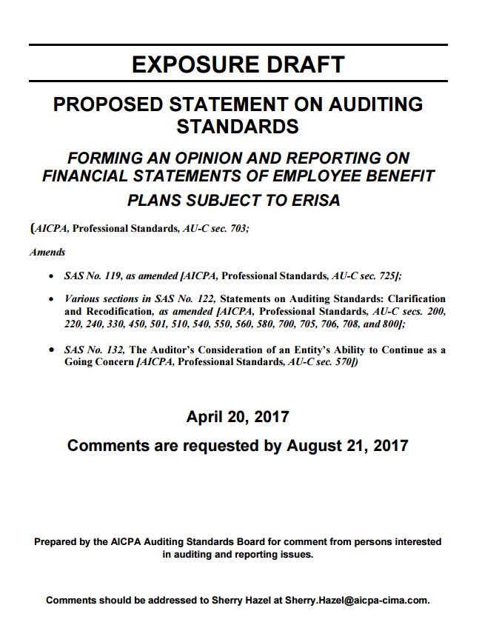
Auditor Reporting – EBP ERISA audits
Proposed new AU-C section (703)
Revisions to auditor’s report on ERISA plan financial statements to enhance audit quality and provide better insight into responsibilities of management and the auditor
Proposed SAS includes:
Form and content of unmodified opinion (AU-C 700 would no longer apply for ERISA plans)
Procedures and new opinion for ERISA limited scope audit
Procedures and reporting requirements on findings from procedures performed on specific plan provisions relating to the financial statements
Comment Period Ended
September 29, 2017
#AICPAgov
Notes:
[ERICA]
ASB is considering the matters outlined on the slide to be dealt with in a new standard.
Issued April 20, 2017, 120 day comment period

Slide 17
Auditor Reporting – EBP ERISA audits
The new form of report in the proposed SAS would require
A new Basis for Limitation on the Scope of the Audit section
Expanded management and auditor responsibilities sections
A special form of opinion on the ERISA plan financial statements that includes:
the audit procedures performed on the information not covered by the certification,
management’s obtaining of an appropriate certification that is provided to the auditor, and
the procedures performed on the certified information, as required by the proposed SAS
Notes:
[ERICA]
The new form of report in the proposed SAS would require:
A new Basis for Limitation on the Scope of the Audit section
Expanded management and auditor responsibilities sections
A special form of opinion on the ERISA plan financial statements that is based on the audit and on the use of the certification of the investment information that the auditor was instructed not to audit. This includes:
the audit procedures performed on the information not covered by the certification,
management’s obtaining of an appropriate certification that is provided to the auditor, and
the procedures performed on the certified information, as required by the proposed SAS
An other-matter paragraph that provides an opinion on whether the supplemental schedules are fairly stated in all material respects in relation to the financial statements as a whole, and an opinion on whether the form and content of the supplemental schedules are presented in conformity with the DOL’s rules and regulation for reporting and disclosure under ERISA. The opinion provided in the other-matter paragraph is based on the audit and based on the use of the certification of the investment information that the auditor was instructed not to audit
A by-product report that reports findings on specific plan provisions relating to the financial statements (as discussed in Report on Findings section previously)
Certain aspects of the new form of report would be precluded when a scope limitation (other than the ERISA-permitted audit scope limitation) or an uncorrected material misstatement existed.

Slide 18
Proposed SAS: Auditor Reporting
Exposure Draft Expected to be Available October 2017
Goal
Enhancing the communicative value and relevance of the auditor’s report
New section
701: Communicating Key Audit Matters in the Independent Auditor’s Report
Amends
700
705
706
260
570
Notes:
[ERICA]
ISA 700, Forming an Opinion and Reporting on Financial Statements
ISA 705, Modifications to the Opinion in the Independent Auditor’s Report
ISA 706, Emphasis-of-Matter Paragraphs and Other-Matter Paragraphs in the Independent Auditor’s Report
ISA 260, Communication with Those Charged with Governance
ISA 570, Going Concern
Goes further in eliminating differences with the ISAs and also with PCAOB reporting. Avoid unnecessary differences with the PCAOB.
From the Wrap Document of the Draft ED:
The call for changes to the auditor reporting model in the United States and other jurisdictions around the world has resulted from a desire by users of financial statements and the auditor’s report for more information about significant aspects of the audit. Input was received from investors and other users, as well as regulators, corporate governance organizations, auditors and others, in response to a number of proposals and requests for public comment from standard-setters relating to changes to the auditor’s report. Several key themes emerged from that process:
Users indicated that they continued to value the “pass/fail” nature of the auditor’s opinion, but that the remainder of the auditor’s report was boilerplate in nature and provided little transparency into the audit.
In particular, users desired more and better information about those areas of the audit that posed higher risks of material misstatement or involved complexity and judgment by management and the auditor.
Users and other stakeholders also supported expanding the description in the auditor’s report of the responsibilities of management for the preparation of the financial statements, and of the auditor for the audit of the financial statements, as a way of addressing the long-standing expectations gap.
The Auditing Standards Board (ASB) has monitored developments related to the auditor reporting model in the United States and internationally. In particular, the ASB followed the auditor reporting projects of the International Auditing and Assurance Standards Board (IAASB) and Public Company Accounting Oversight Board (PCAOB). See further discussion about these projects below. The ASB Auditor Reporting Task Force was formed to consider the implications of these projects on auditor’s reports issued for audits of non-issuers.
Effective Date
The proposed SASs and related proposed amendments would be effective no earlier than for audits of financial statements for periods ending on or after June 15, 2019, depending on the timing of finalizing the proposed standards and amendments. Because the proposed standards and amendments are interrelated, all would be required to be adopted concurrently. It is anticipated that early implementation will not be permitted.

Slide 19
Proposed SAS: Auditor Reporting
Opinion section mandated first
New sections:
Key Audit Matters --
Optional to include but requirements if opt to include
“What keeps the auditor up at night”
Expanded descriptions of auditor and management responsibility, including relating to going concern
Other Information
When presented with the audited financial statements
Other proposed improvements to enhance transparency and clarify responsibilities
#AICPAgov
Notes:
[ERICA]
KAM would be optional in GAAS, but if option selected to report KAM, requirements apply
Similar to Critical Audit Matters (CAM) from the PCAOB
From Wrap Document of the Draft ED:
The following summarizes what the ASB believes would be the most significant changes resulting from the proposed SAS compared to extant AU-C section 700:
Requires the “Opinion” section to be presented first in the auditor’s report, followed by the “Basis for Opinion” section, unless law or regulation prescribe otherwise (paragraphs 22-26)
Requires the “Basis for Opinion” section of the auditor’s report to include an affirmative statement about the auditor’s independence, and fulfillment of the auditor’s other ethical responsibilities, in accordance with relevant ethical requirements relating to the audit (paragraph 26(c))
Requires the auditor to report in accordance with AU-C section 570, The Auditor’s Consideration of an Entity’s Ability to Continue as a Going Concern (see further discussion in the “Proposed Amendments” section) (paragraph 27)
Communication of KAM would not be required for audits of non-issuers. However, if done as part of the terms of the audit engagement, the auditor would be required to do so in accordance with proposed SAS, Communicating Key Audit Matters in the Independent Auditor’s Report (paragraph 28)
Requires the auditor to report in accordance with proposed SAS, The Auditor’s Responsibilities Relating to Other Information Included in Annual Reports (see further discussion in the “Other Projects Relating to Auditor Reporting” section) (paragraph 29)
Expands the description of the responsibilities of management for the preparation and fair presentation of the financial statements, and includes a requirement to identify those responsible for the oversight of the financial reporting process, when those responsible for such oversight differ from those responsible for the preparation of the financial statements (paragraphs 30-33)
Expands the description of the responsibilities of the auditor and key features of an audit (paragraphs 34-37)

Slide 20
Proposed SAS: Illustrative Report
INDEPENDENT AUDITOR’S REPORT
[Appropriate Addressee]
Opinion
We have audited the financial statements of ABC Company, which comprise the balance sheet as of December 31, 20X1, and the related statements of income, changes in stockholders’ equity and cash flows for the year then ended, and the related notes to the financial statements.
In our opinion, the accompanying financial statements present fairly, in all material respects, the financial position of ABC Company as of December 31, 20X1, and the results of its operations and its cash flows for the year then ended in accordance with accounting principles generally accepted in the United States of America.
Notes:
[ERICA]

Slide 21
Proposed SAS: Illustrative Report
Basis for Opinion
We conducted our audit in accordance with auditing standards generally accepted in the United States of America. Our responsibilities under those standards are further described in the Auditor’s Responsibilities for the Audit of the Financial Statements section of our report. We are independent of ABC Company and have fulfilled our other ethical responsibilities in accordance with the relevant ethical requirements relating to our audit. We believe that the audit evidence we have obtained is sufficient and appropriate to provide a basis for our opinion.
Notes:
[ERICA]

Slide 22
Proposed SAS: Illustrative Report
Key Audit Matters
[Not Required – May be Included at the Auditor’s Discretion]
Key audit matters are those matters that were communicated with those charged with governance and, in our professional judgment, were of most significance in our audit of the financial statements of the current period. These matters were addressed in the context of our audit of the financial statements as a whole, and in forming our opinion thereon, and we do not provide a separate opinion on these matters.
[Description of each key audit matter in accordance with AU-C 701.]
Notes:
[ERICA]

Slide 23
Proposed SAS: Illustrative Report
Other Information [or another title if appropriate such as “Information Other than the Financial Statements and Auditor’s Report Thereon”]
[Reporting in accordance with the reporting requirements in proposed SAS The Auditor’s Responsibilities Relating to Other Information Included in Annual Reports – see Illustration 1 in appendix of that proposed SAS.]
Notes:
[ERICA]

Slide 24
Proposed SAS: Illustrative Report
Responsibilities of Management and Those Charged with Governance for the Financial Statements
Management is responsible for the preparation and fair presentation of the financial statements in accordance with accounting principles generally accepted in the United States of America; this includes the design, implementation and maintenance of internal control relevant to the preparation and fair presentation of financial statements that are free from material misstatement, whether due to fraud or error.
In preparing the financial statements, management is responsible for assessing the Company’s ability to continue as a going concern in accordance with accounting principles generally accepted in the United States of America, and using the going concern basis of accounting unless management either intends to liquidate ABC Company or to cease operations, or has no realistic alternative but to do so.
Those charged with governance are responsible for overseeing ABC Company’s financial reporting process.
Notes:
[ERICA]
May want to point out the going concern language and that it may cause issues for audits of SLGs. Encourage comments to that effect.

Slide 25
Proposed SAS: Illustrative Report
Auditor’s Responsibilities for the Audit of the Financial Statements
Our objectives are to obtain reasonable assurance about whether the financial statements as a whole are free from material misstatement, whether due to fraud or error, and to issue an auditor’s report that includes our opinion. Reasonable assurance is a high level of assurance, but is not absolute assurance and therefore not a guarantee that an audit conducted in accordance with generally accepted auditing standards will always detect a material misstatement when it exists. Misstatements can arise from fraud or error and are considered material if, individually or in the aggregate, they could reasonably be expected to influence the economic decisions of users taken on the basis of these financial statements.
As part of an audit in accordance with GAAS, we exercise professional judgment and maintain professional skepticism throughout the audit. We also:
Notes:
[ERICA]
Note: only the UK uses the option to link to description on a website. Website is FRC’s – they are the regulator/standard-setter.

Slide 26
Illustrative Report
Further Description of Auditor’s Responsibilities for the Audit of the Financial Statements
Identify and assess the risks of material misstatement of the financial statements, whether due to fraud or error, design and perform audit procedures responsive to those risks, and obtain audit evidence that is sufficient and appropriate to provide a basis for our opinion. The risk of not detecting a material misstatement resulting from fraud is higher than for one resulting from error, as fraud may involve collusion, forgery, intentional omissions, misrepresentations, or the override of internal control.
Obtain an understanding of internal control relevant to the audit in order to design audit procedures that are appropriate in the circumstances, but not for the purpose of expressing an opinion on the effectiveness of ABC Company’s internal control. Accordingly, no such opinion is expressed.
Evaluate the appropriateness of accounting policies used and the reasonableness of significant accounting estimates made by management, as well as the overall presentation of the financial statements.
Conclude on ABC Company’s ability to continue as a going concern and conclude on the appropriateness of management’s use of the going concern basis of accounting.
We communicate with those charged with governance regarding, among other matters, the planned scope and timing of the audit and significant audit findings, including any significant deficiencies and material weaknesses in internal control that are identified during our audit.
Notes:
[ERICA]

Slide 27
Proposed SAS: Illustrative Report
Report on Other Legal and Regulatory Requirements
[The form and content of this section of the auditor’s report would vary depending on the nature of the auditor’s other reporting responsibilities.]
[Signature of the auditor’s firm]
[Auditor’s city and state]
[Date of the auditor’s report]
Notes:
[ERICA]

Slide 28
Interpretive Publications and Other Projects

Slide 29
Interpretative Publications - Related Assurance Services: Upcoming Guides
Data Analytics
New guide to supplement Analytical Procedures Guide
Address use of data analytics and other analytical procedures
Cyber Security (released)
What’s the effect on the audit of historical financial statements?
What types of attestation engagements could be performed?
Sustainability
New attestation guide
Revenue Recognition
Notes:
[ERICA]
the work in these areas does not stop with the issuance of the guides…for example the work on cyber and sustainability has resulted in a project to better define and determine qualitative materiality measures; the cyber team is looking at possible alternative criteria such as developing maturity model criteria to report against.

Slide 30
#AICPAgov

