Slide 1


Lighting the Fire
Strategies to fuel the future of learning
Name of presenter
Audience
Date

Slide 2
Topics for discussion
The business, profession and workplace evolution
The learning revolution
Future of Learning recommendations
Learn more

Slide 3
The business, profession and workplace evolution

Slide 4
Business and profession transform
Disruptors emerge overnight
Increased regulation
Hyper-specialization
Globalization adds complexity
Technologies transforming business
Notes:
Globalization and increasing complexity
Specialization and technology
The emergence of business growth outside of the most-developed regions of the world
All of these factors are directly impacting and transforming the accounting profession and creating new challenges for our professionals to face and conquer on behalf of their clients and the public interest.

Slide 5
Workplace evolves — 2020 Outlook
Acute global talent shortage
Corporate curriculums will use game mechanics
Hiring/promotion based on reputation capital
Lifelong learning becomes a business requirement
Peer-to-peer learning is preferred method of learning
Mobile devices – office, classroom, virtual concierge
Social media literacy required
Source: The 2020 Workplace
Notes:
As the business and profession evolve, so too does the workplace.
The workplace of the future will be very different from the workplace we are familiar with now.
Top talent will be technology-literate, constantly learning and very mobile.
CPAs will demand that their organizations provide constant and technology-enabled learning to enable them to meet the needs of both their clients and their profession.

Slide 6
The learning revolution

Slide 7
Learner’s expectations have changed
Competency plus compliance
Relevant and contextual
Collaborative, interactive, participative
Mentoring and coaching
Just in time, blended, tech-enabled
Notes:
Expectations have changed.
It is no longer enough to be compliant with standards. Learners are asking for education and information to help them build competency.
The information needs to be relevant and timely to their needs.
Collaboration, Participation, Mentoring and Coaching – all of these less formal learning opportunities are becoming more and more valued.
Changes in technology are enabling and driving the demand for learning when it is wanted, and how it is wanted, delivered seamlessly through the learner’s channel of choice.

Slide 8
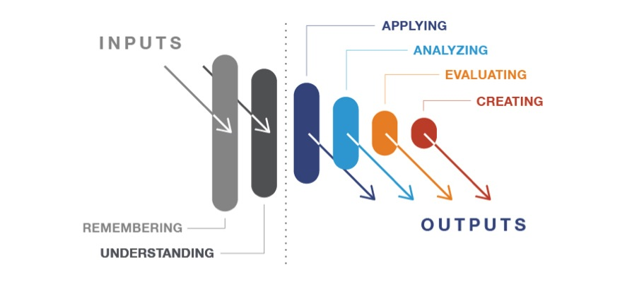
Making learning meaningful
Creating
Creating
Evaluating
Evaluating
Analyzing
Analyzing
Applying
Applying
Understanding
Understanding
Remembering
Adapted from "Bloom's Taxonomy of Learning Domains" by Dr. Benjamin Bloom, 1956
Notes:
Competency models that focus upon output versus a mere unit of time spent are moving to the forefront of education.
Bloom’s Taxonomy is an educational standard that shows how, as one foundationally builds upon learning and knowledge and moves up the pyramid, the complexity and mastery needed to drive proficiency increases.
Time based learning is foundational, but competency and output-based learning is advanced.

Slide 9
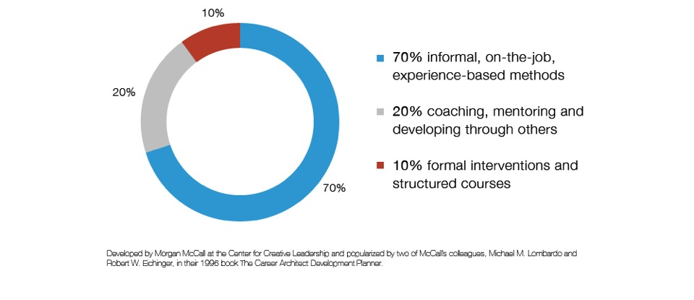
How we really learn
Notes:
When thinking about learning and the pyramid, there is a realization that in order to achieve competency, proficiency and mastery, the learner must learn both formally and informally.
The learning that is currently focused upon by our profession – CPE – only constitutes 10% of the learning that our professionals actually do.
20% of learning is on the job. CPAs have traditionally done this well, but the apprentice model has been changing as the workforce becomes more mobile and CPAs change organizations more frequently.
70% of learning is through the experiential opportunities, such as mentoring, coaching, collaborating, participating. It’s an output-based learning, not an input-based learning.

Slide 10

Blended learning environments rise in importance and prevalence
Notes:
The traditional one-size-fits-all way of learning is becoming outmoded.
Learners are demanding a blended learning environment that merges in-person experiences with virtual experiences with interactive experiences with on-demand and just-in-time information. They want the formal and the informal learning opportunities across different environments at the same time.

Slide 11
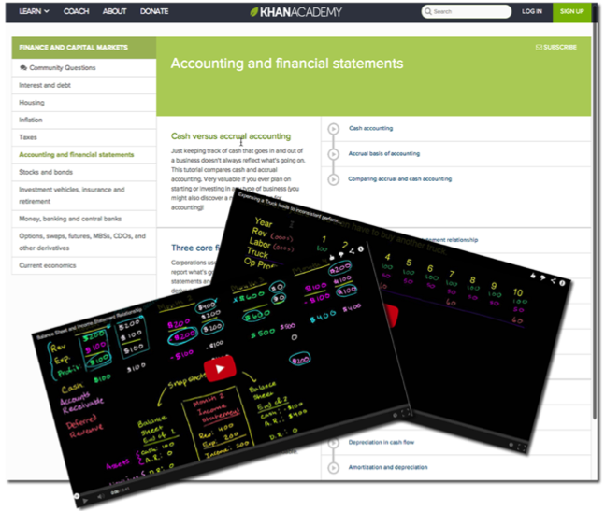
Technology enables personalized, adaptive learning
Notes:
Personalized learning:
Onset tailoring
Intuition-driven, data informed
Adaptive
Evolves in real-time
Data-driven
Technology—enables, enhances

Slide 12

Mentoring and peer-to-peer learning on the rise
Notes:
Informal and more personalized learning is continuing to grow in popularity and importance.
Professionals who strive to be lifelong learners are seeking out mentors and trusted peers upon whom to model their behavior and from whom to gather important and relevant information.

Slide 13
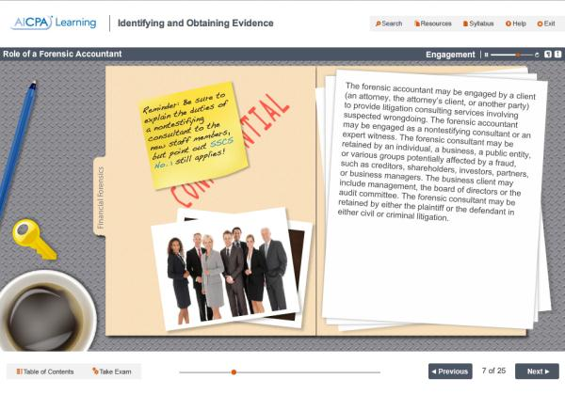
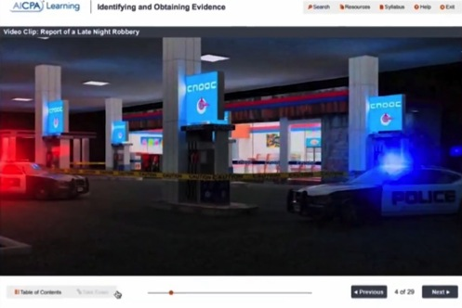
Gaming and simulation improving outcomes
Notes:
Gaming techniques are becoming recognized for driving better learning outcomes – especially from an engagement and retention perspective.
We have a short video for you to watch on ways that gaming and simulation can be and are being incorporated into continuing professional education.

Slide 14

Future of Learning
Recommendations

Slide 15

Future of Learning Recommendations
Innovate and Experiment
Ignite a Passion for Learning
Make Learning Personal
Measure What Matters

Slide 16

Innovate and Experiment
Leverage technology to enhance learning experiences
Adapt and evolve learning to meet the needs of
high-performing professionals
Small changes to learning can have a huge impact
Notes:
Innovate & Experiment
Business, the profession and workplace will continue to evolve, and become more global and complex.
As a result, learning must adapt and evolve to support CPAs in their efforts to maintain their competitive edge and protect the public interest.
After decades of one-size-fits-all learning, we are looking toward a future that will be iterative. There is no silver bullet.
Experimentation and innovation will be essential to allow us to discover the best path forward.
Our recommendations are straightforward.
{on click} Leverage technology to enhance learning experiences.
Take a lesson from current technology development, be agile and take an incremental approach.
This means start small; pilot iterative releases that leverage learning analytics and learner needs to ensure you are delivering experiences that create success.
And, to create optimum learning experiences, incorporate plug-and-play, best-of-breed learning solutions. Getting out of the build-it-yourself mentality allows learning providers to focus on what they do best, creating and delivering learning, as well as allows for more frequent adoption of new technologies.
{on click} Small changes to learning can make a huge impact
The rapid evolution of learning technologies can make the decision about which technologies to adopt, and how often, a difficult one. Find a sweet spot that balances investment and risk in a way that feels comfortable.
Small, incremental changes should be used to evolve learning methods. Pilot programs such as blending live classroom instruction and discussion with prework so that time in the classroom is focused on applying the learning, not just memorizing facts. Or, to create more authentic learning experiences, incorporate case studies, simulations and scenario-based learning,

Slide 17

Ignite a Passion for Learning
Start with
the learner
Create meaningful, purposeful experiences that motivate and engage learners
Make learning engaging
and relevant
Notes:
Ignite a Passion for Learning
Nothing motivates and engages learners like meaningful, purposeful experiences.
Whether you create regulation, develop employees or deliver learning, challenge yourself to answer the following, Education for what purpose? If you keep this in mind you will help professionals make the most out of each learning experience.
{on click} Start with the learner.
In today’s workplace, where professionals are expected to do more, faster, a key way to engage learners is to create a connection between professional development and career growth. Newer generations of workers, however, prefer to look at their careers as a lattice, not a ladder; therefore, employers should use flexible competency models and related tools to support a clear vision for the path forward.
Empowering students to be facilitators of the learning experience often creates a passion for learning and will enhance job performance. Since 20% of our learning comes from peer-to-peer interactions, learning facilitators (including employee supervisors) should engage students to be teachers as often as is practical.
Most learners are motivated when given an opportunity to see how a professional development experience builds their competency and ultimately enhances their job performance.
Learning providers should use tools such as case studies, simulations and scenario-based learning to provide direct links to learners’ performance. The problem-solving nature of these methods, create learning that is both entertaining and experiential.
In addition to ongoing competency building in technical areas, it is critical that employers and regulators allow and encourage the development of success skills such as people, leadership and business acumen.
Not only are they core to ensuring we have professionals who can make sense of complex issues and exercise professional judgment, but they also serve as powerful motivators to learners.
{on click} Make learning engaging and relevant.
When learning is goal-driven, for example, through the achievement of a certification or by closely aligning with an opportunity to enhance performance, learners are more engaged and results follow.
To increase engagement, take a lesson from gaming. While utilizing game mechanics is not a silver bullet, gamification taps deeply into the human psyche, and triggers intrinsic motivation.
This does not mean that all learning should feel like a video game, only that gaming components such as rewards, competition and feedback based on achievement can be incorporated into successful learning programs.

Slide 18

Make Learning Personal
Create learning opportunities that address individuals’ knowledge and competency needs
Filter content and
focus resources
Design for
desired outcome
Deliver any topic,
anywhere, any way
Notes:
Making Learning Personal
For the pursuit of learning to be lifelong, it has to be personal and meaningful.
This is achieved by providing relevant learning opportunities that address the knowledge and competency needs of individual learners.
{On click} Filter content and focus resources.
The profession rightly takes satisfaction from a body of knowledge that is as deep as it is wide. But no one can, nor should, be an expert in everything.
Instead, develop meaningful learning experiences by offering content in small modules such as micro/nano learning, just-in-time learning and self-paced learning. And ensure you’re delivering content that is relevant and contextualized for the learner at the current point in his or her career, at the appropriate level of complexity.
{On click}Design for desired outcome.
Stop thinking only about what the learner needs to know and start focusing on what the learner needs to do, including applying, analyzing, evaluating and synthesizing information.
Choose your educators wisely; sometimes you need a subject-matter expert to deliver a deep dive, and other times you need a learning facilitator.
Place value on interactions and collaborations. Hybrid learning approaches are here to stay, and in this complex world, problems can’t be solved with a linear, one-way learning format.
When you design for a desired outcome, remember that you also need to assess whether you’ve hit the mark. With learning analytics that measure individual outcome, you can optimize learning programs, making them personal to the learner, and better ensure the learner has truly learned what you want them to know.
Finally, building feedback into learning programs and assessments allows the learner to understand the purpose of the learning, on what they are being assessed, and what the path forward is.
{on click}Prepare for any topic, anywhere, any way.
Increasing levels of complexity and change result in the need for specialization, making scaled and focused learning objectives even more important
To target learning preference, content must be delivered to accommodate how the individual learns best.
Customization not only includes offering a variety of formats and delivery mechanisms, but also tailoring experiences to different learning styles, and giving learners the opportunity to choose.

Slide 19

Measure What Matters
Learning happens everywhere and can’t always be quantified in a test result or measured in hours
Create and leverage a unified, global competency framework
Develop one uniform, global compliance standard
Rethink how CPE is measured
Notes:
Measure What Matters
Learning happens everywhere, and the greatest moments that advance thinking generally strike like a lightning bolt.
As such, the demonstration of competency and professional development can’t always be quantified in a test result or measured in hours.
We must shift compliance so that it is authentic and relevant, and measures learner competency, development or performance.
{on click} Create and leverage a unified, global competency framework.
For as long as there have been workplaces, the ability to demonstrate competence has been a differentiator. For the public, employers and other stakeholders to have confidence in the competency of CPAs, the profession must embrace one, unified global competency framework.
Professionals should not only master technical competencies, but also competencies related to people, leadership and business acumen. These success skill competencies not only enhance performance in current positions, but also provide meaningful development opportunities that span a career.
Competency measurement should include both inputs and outputs and be both quantitative and qualitative. Just as there are multiple ways to learn, there are multiple ways to demonstrate the achievement of a competency. This models how the workplace, the profession and business already operate — with multiple paths to a correct answer.
{on click}Develop one uniform, global compliance standard.
Business is global, workplaces are global and the public interest is global. Our compliance standard must be global. Such a standard must be dynamic and multi-faceted to allow for development plans that are competency driven, and therefore personal and flexible.
Compliance models should recognize all learning that can be tied to the development of professional competency, whether input- or output-based, qualitative or quantitative, formal, informal, or experiential.
For example, when a professional writes his first business plan or negotiates her first major contract, competency is being developed.
Subsequently, when the scope of such projects grow due to global expansion or intellectual property rights, competencies continue to develop, and the public, employers and stakeholders benefit from such competency development.
Similarly, the discussion of those same plans and negotiations with more senior professionals or experts in other fields creates learning opportunities that further competency development.
None of these valuable experiences can be easily or consistently measured in a time-bound way, but nonetheless, they should count.
The profession and its regulators must develop a compliance model that accepts non-time-bound measurements of competency development based on outputs.
It won’t be easy, so stakeholders should engage in pilot programs, measure and challenge results prior to making recommendations for how to implement this profession-wide change.
When the time comes to make specific recommendations, the profession must embrace a compliance model that is evolutionary and principles-based to allow for new processes, flexible inputs and targeted outputs.
{on click}Rethink how CPE is measured.
While the optimal end game is a multi-faceted professional development model, some time-bound measurements might remain during transition or evolutionary periods.
However even while they do remain, the compliance model must allow smaller increments of time to count toward recognized learning. The unit of time measured should be such that a learning objective can be met and a competency measured.

Slide 20

JOIN US.
futureoflearning.aicpa.org

