Slide 1
Current Expected Credit Loss (CECL) Accounting Standard:
An Introduction for Bank CEOs and their Board
aba.com |1-800-BANKERS

Slide 2
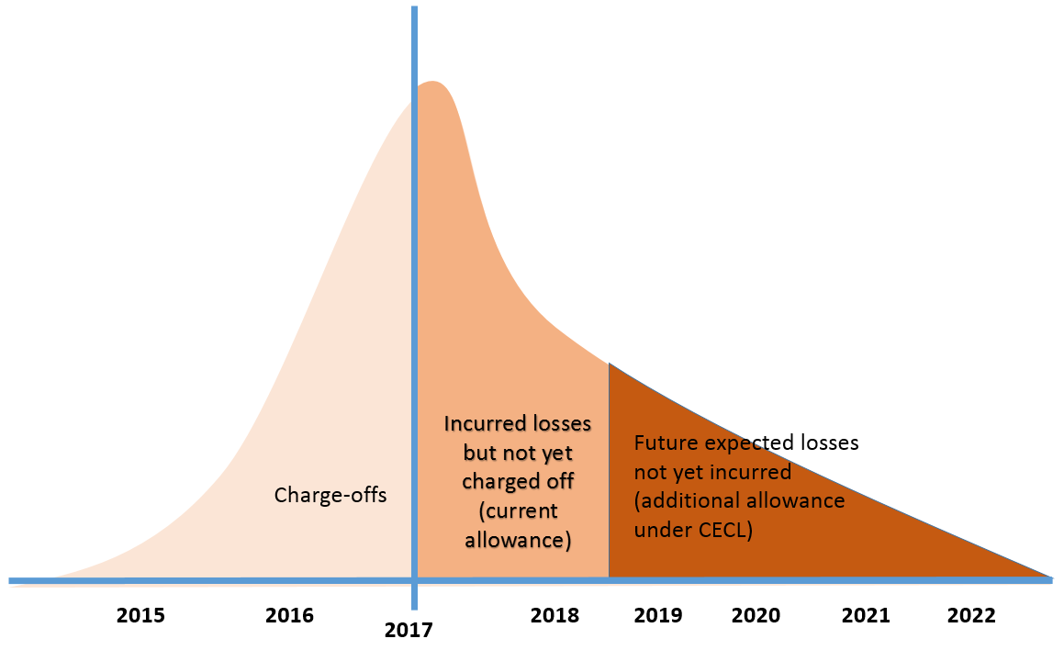
The Change to CECL
FAS 5:
“Losses in the Portfolio”
CECL:
“Risk in the Portfolio”
Estimate of “Incurred loss”
Estimate of “Expected loss”

Slide 3
CECL: Expected credit losses over life of loan or portfolio
Life of Loan (LOL) loss expectation (pool basis) effectively recorded at origination
Forecast of the future to LOL required
Historic averages of “life of loan” losses
Used as starting point for estimates
Applied to periods beyond “forecastable future.”

Slide 4
So what does this mean for me?
Credit losses will be recognized earlier in my financial statements
My current process to estimate my allowance will need to change
Periods of directional inconsistency between performance metrics and the provision

Slide 5
Where to start?
Assess my current ALLL reserve process:
How do I currently estimate the reserve (data, model, governance)?
What additional information or modeling tools will I require to expand my estimate to estimate for life of loan?
Communication:
Can I get out in front and share your assessments and pitch your solutions to your auditors/regulators to get them on board?
Can I involve other parts of the bank to ensure a consistent view between accounting, credit and others?
Allocate resources:
Do the right people have the time needed to assess and implement the necessary changes?
Do I need external expertise or tools?
Other considerations:
How will this impact my capital and do I need to start planning now to adjust?
Can I unlock value from the life of loan estimate to use in pricing or credit decisions?

Slide 6
Implementation considerations?
Data to support life of loan loss, Q factor estimates
Vintage information
Further segmentation by credit risk characteristics
Forecasting the future
Governance:
Documentation
Internal controls

Slide 7
Biggest CECL Challenges
1. Investors/Mgmt – Communications
Relationship of traditional metrics to provisions no longer continues
New Metrics needed
2. Auditors – Supporting documentation
Life of loan, more granular data needed
Quantifying forecasts of the future
3. Regulators – Aligning CECL
To capital management, ALM, budgeting and planning

Slide 8
Transitioning to 2020/21
Governance
SEC: 2020
Rest: 2021
Scoping
Data
Measurement & Metrics
Processes & Optimize
Engage External Parties

Slide 9
What to do now?
Educate
Communicate with your stakeholders
Develop a plan
Notes:
c

