Slide 1
An Overview of the New Comprehensive Definition of Attest
Gary McIntosh
AICPA Co-Chair, Uniform Accountancy Act Committee
September 9, 2014

Slide 2
Attest services are unique
Can only be performed by a CPA operating within a CPA firm.
Only doctors should practice medicine, only lawyers should practice law, & certain professional services should only be provided by CPAs

Slide 3

Why are these protections important?
The public relies on these protections
They need to know that when they engage a professional for these attest services that the professional has the
right degree of expertise,
education, and regulatory
oversight – a combination
only available from a CPA,
operating within a CPA firm

Slide 4
Attest
Attest services, as defined before, encompass:
  Audits of financial statements and other engagements performed under the American Institute of CPAs, or AICPA’s, Statement on Auditing Standards (SAS);
  Reviews of financial statements performed under the AICPA’s Statement on Standards for Accounting and Review Services (SSARS);
  Examinations of prospective financial information performed under the AICPA’s Statement on Standards on Attestation Engagements (SSAEs);
  [In some states, compilations]
  And, engagements performed pursuant to the Public Company Accounting Oversight Board (PCAOB), the federal regulator of auditors of publicly traded companies.

Slide 5

Attest
Implicit in attest reports is an expectation that the work was performed by a CPA
Clients know this and understand the value proposition associated with it

Slide 6

Attest
Attest services rely on CPA profession standards
Except for those engagements performed pursuant to the PCAOB, all of the other engagements are engagements performed under standards developed by the AICPA
Non-CPAs do not necessarily
have the expertise, familiarity
and training to appropriately
apply these standards

Slide 7
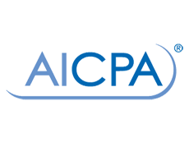

So what has changed?
AICPA, NASBA, and our partners have identified a loophole in the definition of attest
Standards reclassification moved some attest services out of the definition
The market for assurance services also has been changing

Slide 8
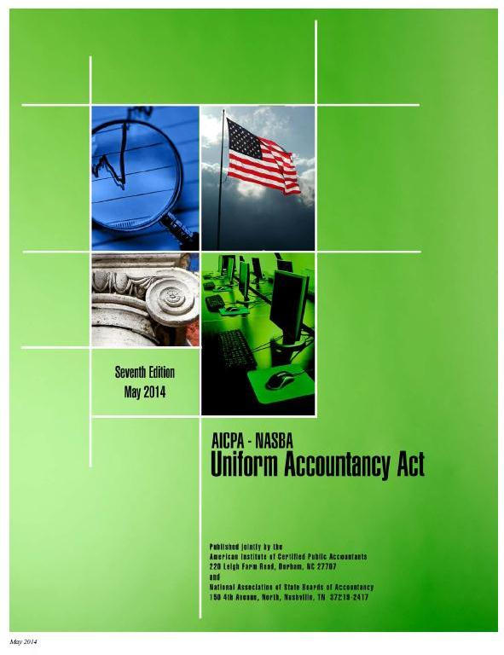
Uniform Accountancy Act (UAA)
Broad agreement that the UAA and state statutes needed to be updated
Risk to the public Need to modernize

Slide 9
Standards Reclassification
SAS 70, Reports on Service Organization Controls (aka SOC Reports), was reissued as SSAE 16 by the AICPA’s Auditing Standards Board (ASB)
June 15, 2011, the ASB determined SAS 70 more accurately fits within the Statement on Standards for Attestation Engagements, or SSAEs, rather than the Statement on Auditing Standards

Slide 10
Standards Reclassification’s Impact on Attest
Technical change had an unintended impact on the definition
While all SAS engagements are covered under the definition of attest, only examinations of prospective financial information were covered under the SSAEs
Now that these “SOC engagements” are performed under the SSAEs, they have fallen out of our definition of attest

Slide 11

Attest
We must fix this situation so that it doesn’t happen again.
Other potential future
reclassifications could
create the same problem
Need to place all SSAEs
under the definition to
protect the public

Slide 12

Scope of Attest Services
Additionally, the scope of attest services has been changing over the past decade.
CPAs are being asked to
provide attest services
on a whole host of new
types of subject matters
The marketplace has been changing rapidly and our original definition did not contemplate this

Slide 13

Scope of Attest Services
Increasingly, clients are asking for attest services to be performed on not just financial statements, but also on a whole host of new types of engagements:
  security and privacy controls,
  sustainability,
  greenhouse gases,
  eXtensible Business Reporting Language (XBRL),
  and many other subject matters.

Slide 14
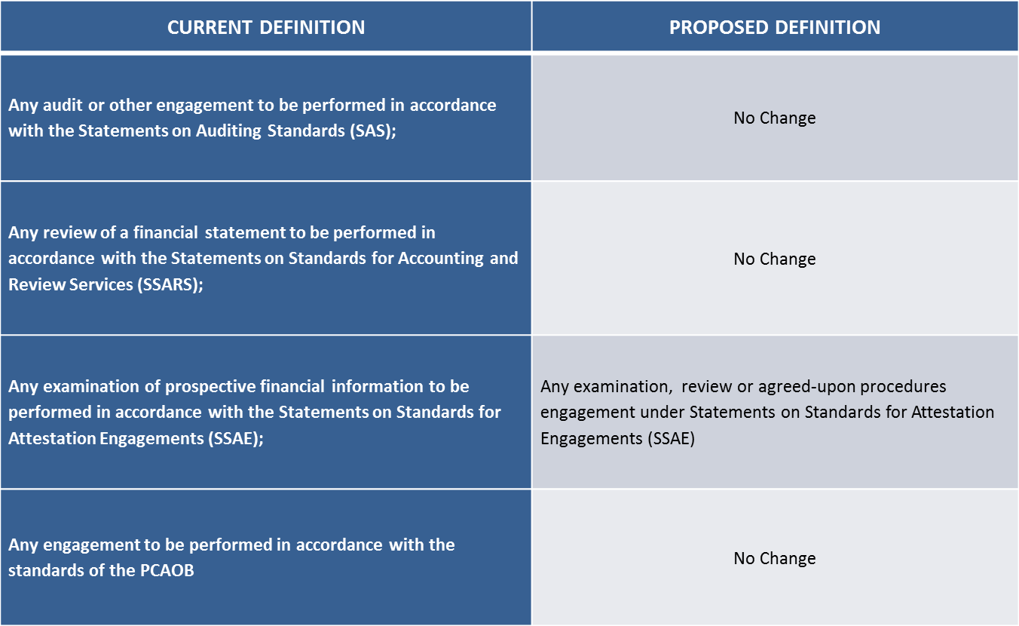
The New Comprehensive Definition of Attest

Slide 15
Attest Public Protection Aspects
CPAs are able and willing to perform these services, but others in the marketplace without the same credentials, experience, and regulation are also offering these services…and they are using the CPA profession’s standards as written under the SSAEs
Not just anyone should be able to associate themselves with the rigorous qualifications and protections that the CPA profession provides
Harmful to the public

Slide 16

How this Effort Protects the Public
It is misleading and confusing when non-CPAs issue reports using AICPA standards
  Implies CPA licensure and a certain level of regulation/government oversight
  Implies CPA competence levels
CPAs are uniquely qualified to perform assurance/attest services
  Education
  Examination
  Experience
  Life-long learning
  Professional ethics (integrity, objectivity, independence, competence)

Slide 17
Is this anti-competitive?
No
Some unregulated individuals issuing attest reports under CPA profession standards may argue that a revised definition of attest limits competition
Non-CPAs should be able to provide lawful services to the public
However, those individuals should not be allowed to use CPA professional standards when they perform assurance engagements

Slide 18
Is this anti-competitive?
The public rightly assumes that the SSAEs, written by and for CPAs, are gold star standards and not just anyone is qualified nor should be allowed to use them
They also assume that our state Board of Accountancy will protect the public in the performance of engagements performed under these standards, but this is not the case if others in the market are using CPA profession standards

Slide 19

What options do non-CPAs have?
If others in the marketplace want to provide similar assurance services, they need to develop their own standards or find generalized standards not unique to the CPA profession.
Clients can then decide
whom they trust to perform
these assurance services,
utilizing which standards.

Slide 20

Challenges, Risks, and Potential Opposition
Non-CPAs who are already performing services
CPA firms whose affiliates perform services
Timing of state legislative sessions
Risk and work level associated
with any legislative effort
Other state priorities
Wisconsin State Capitol Building

Slide 21

Call to action
There is an urgent need to act soon
Risk that the loophole will remain open
Unregulated actors will
continue to offer these
services and their
numbers will grow
Entrenched interests
will make it harder to
fix this public protection issue

Slide 22
Questions?
Mat Young, AICPA Vice President, State Regulation and Legislation myoung@aicpa.org
(202) 434-9273

